Slide 1
PROJECT PRESENTATION FOR “SALMANS”
Team members:
Chinedu Urbanus Ugwu - 610119
John Imhonikhe Lawal - 610098
Mohammed Seud - 109362
IN PARTIAL FULFILMENT OF THE REQUIREMENTS FOR PASSING CS425 – SOFTWARE ENGINEERING, MAHARISHI UNIVERSITY OF MANAGEMENT.
AUGUST, 2019

Slide 2
What is salmans?
A salon appointment scheduling system
Helps customers of a salon make reservations, keeps track of their priorities and enables them to make reviews on the service they received.
Helps the administrator register new hairstylists and assign seat numbers to them.
Assigns hairstylists to customers who have made reservations.
Helps the administrator view summarized business performance information.

Slide 3
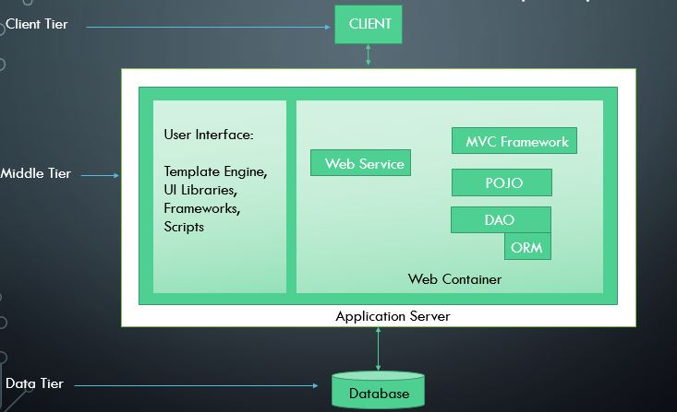
System Architecture Ananlysis

Slide 4
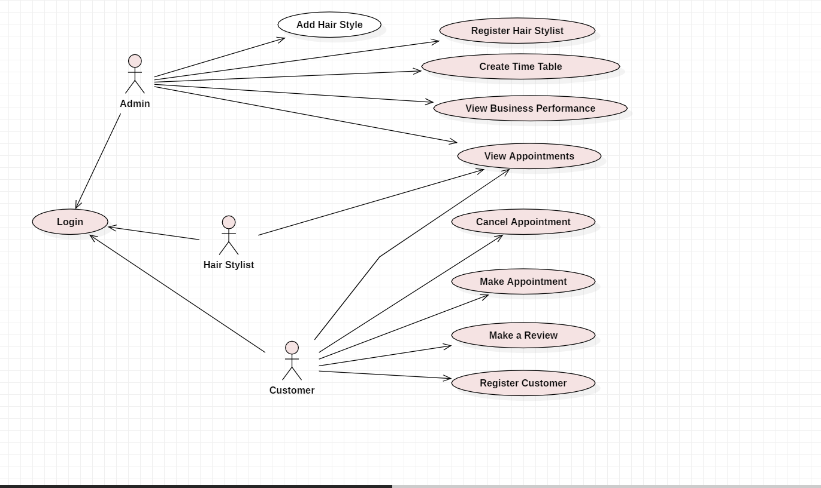
What are the use cases?

Slide 5
System architecture
Client Tier
CLIENT
User Interface:
Thymeleaf
Bootstrap
HTML
CSS
Images
Scripts
Spring MVC
Web Service
Middle Tier
POJO
DAO
Hibernaternate
Web Container
Application Server
Data Tier
Database

Slide 6
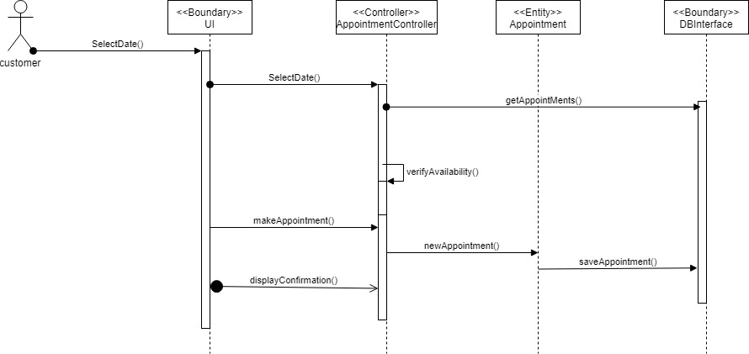
Sequence Diagram For Making Appointment

Slide 7
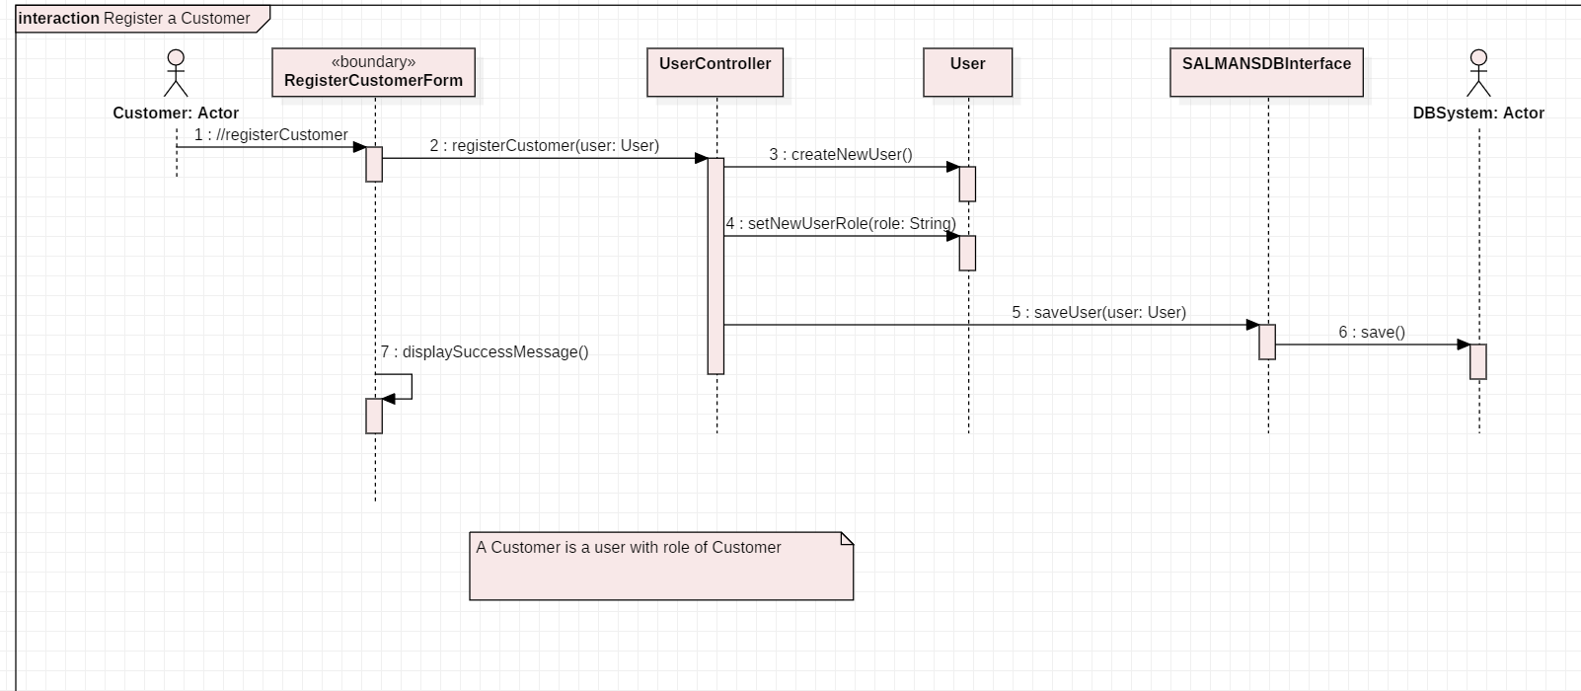
Sequence diagram registering customer

Slide 8
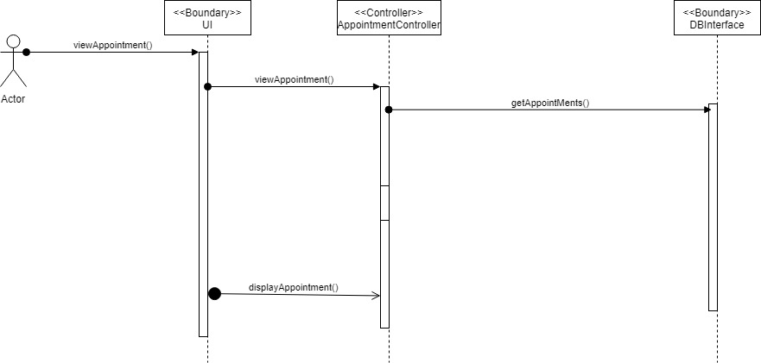
Sequence diagram for view appointment

Slide 9
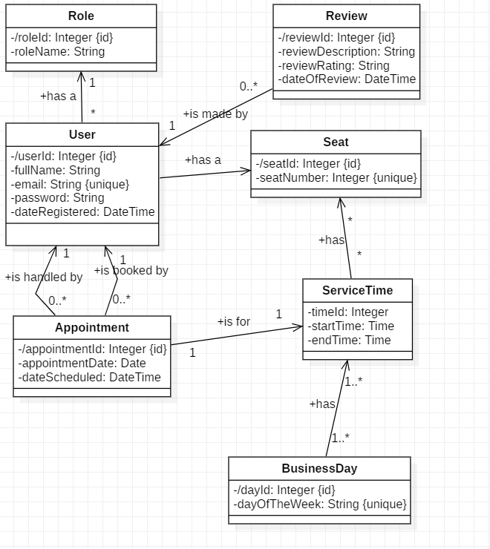
Class diagram of salmans

Slide 10
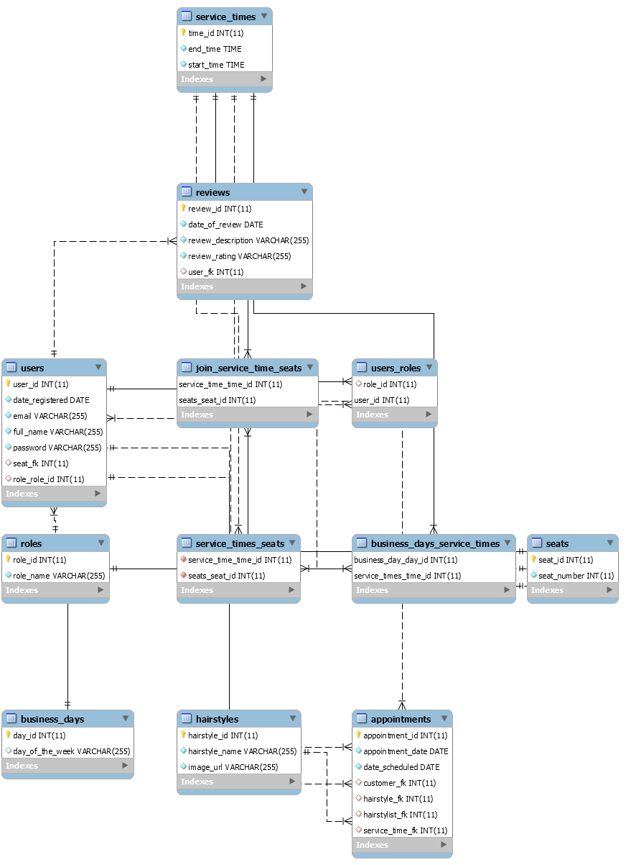
E-r diagram of salmans

Slide 11
Technologies we Used
MVC patterns, layout patterns
Spring Security, Spring Validation
Scrum( daily meetings)
Hibernate, Thyme leaf, MySQL local database
Over All we were follow the RUP SDLC to build this system
We put all the URL’s in one file to make code easier manageable

Slide 12
Technologies we Used cont…
Libraries like jQuery, bootstrap
We create utility package to put all the static variables( like URL’s and some other staffs to help us in managing the files easily)
bCrypt password encoder

Slide 13
THANK YOU

